Slide 1
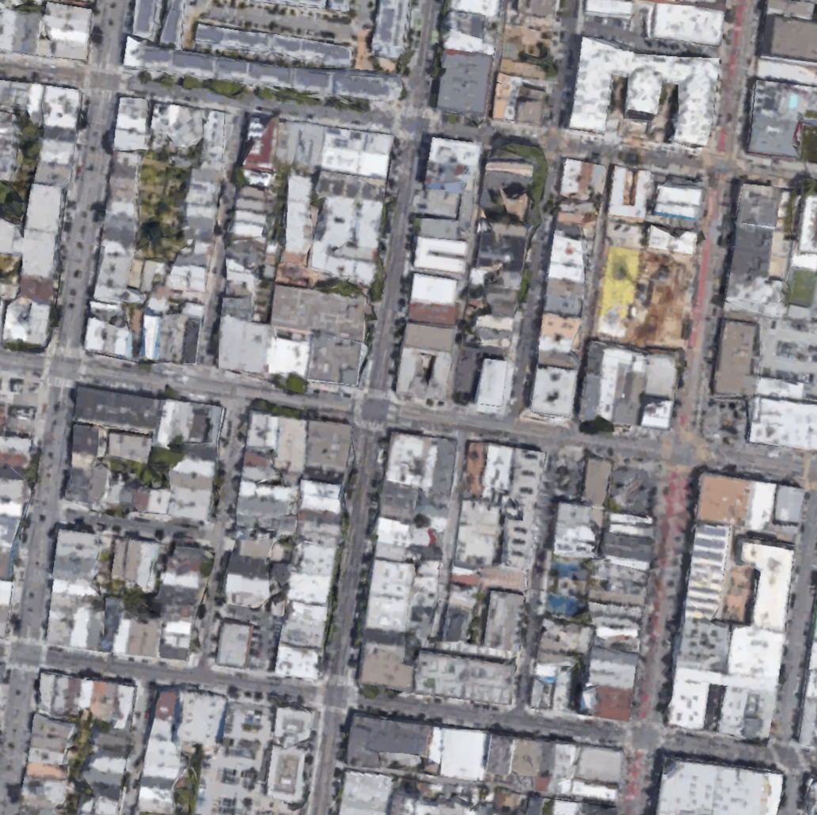
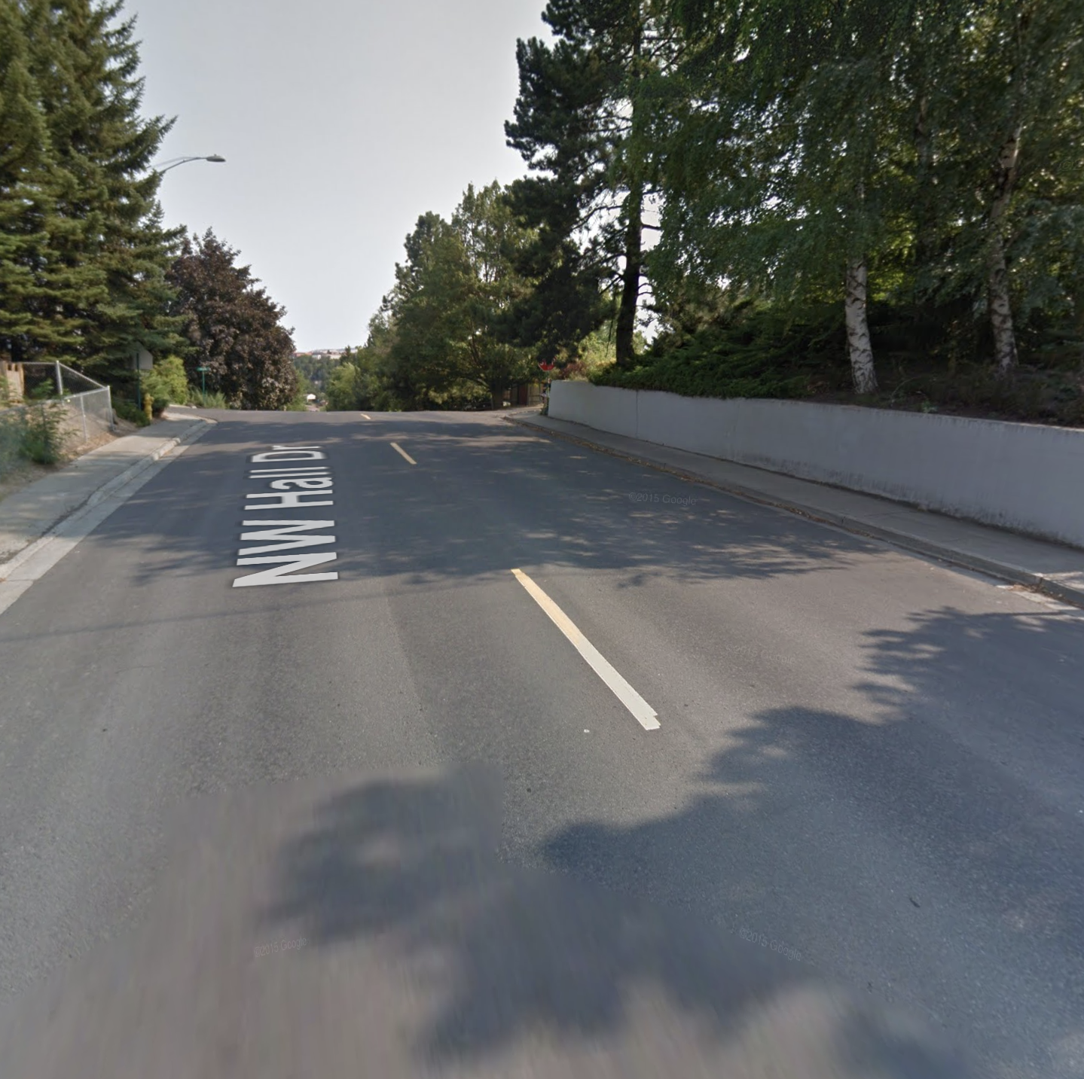
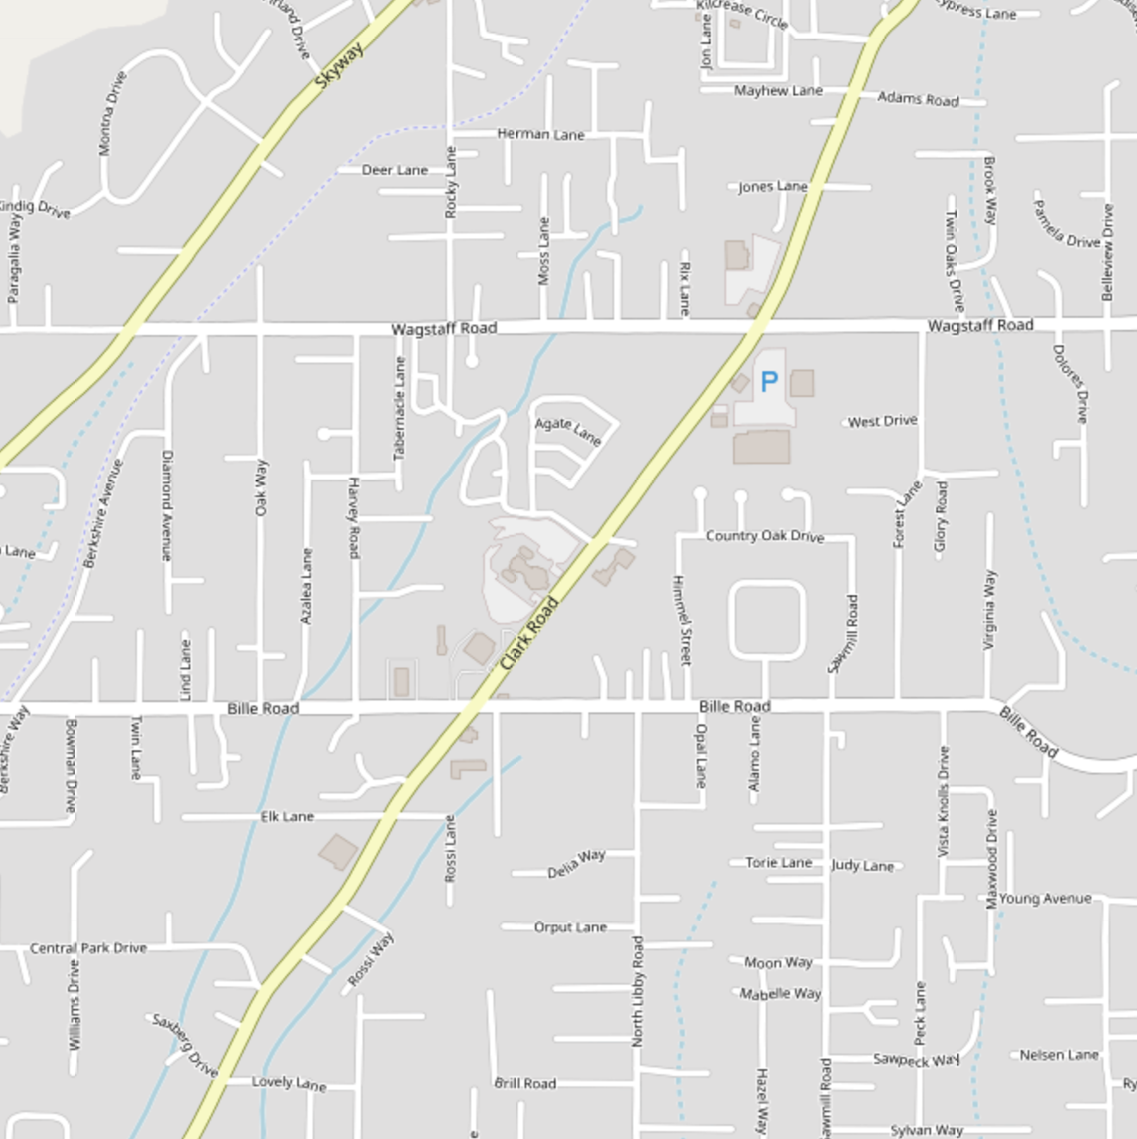



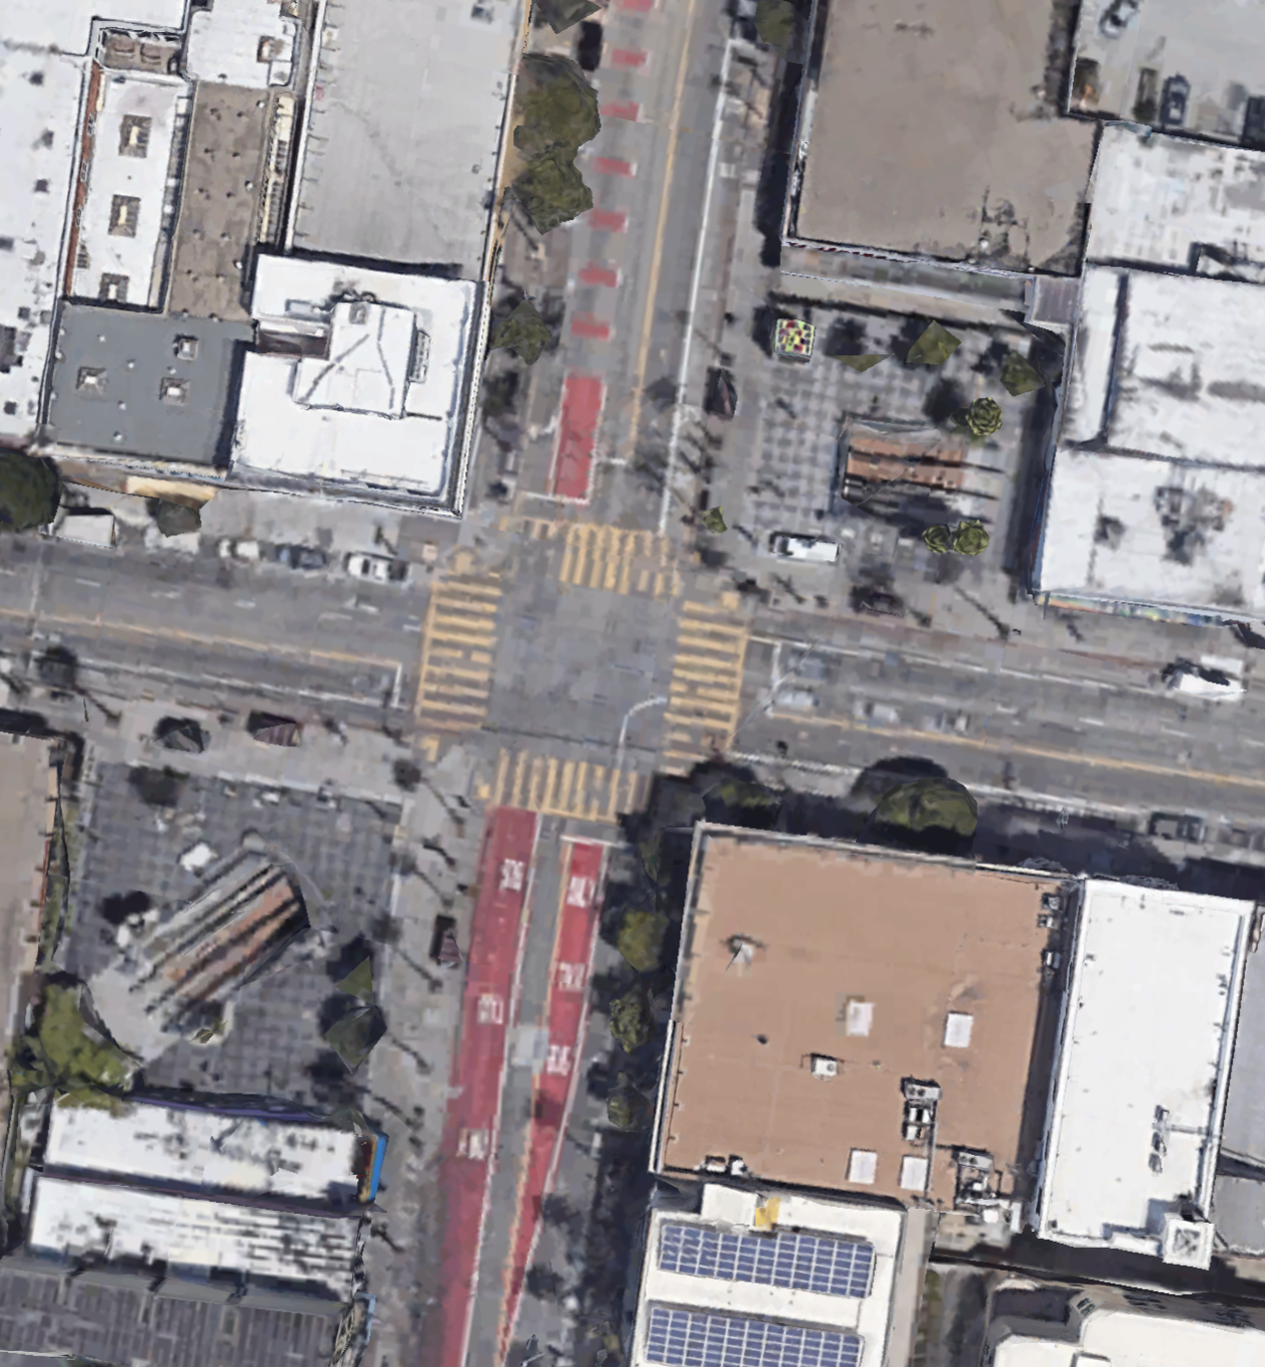
Satellite imagery
Street Views
Open street maps
Lane configuration data

Slide 2

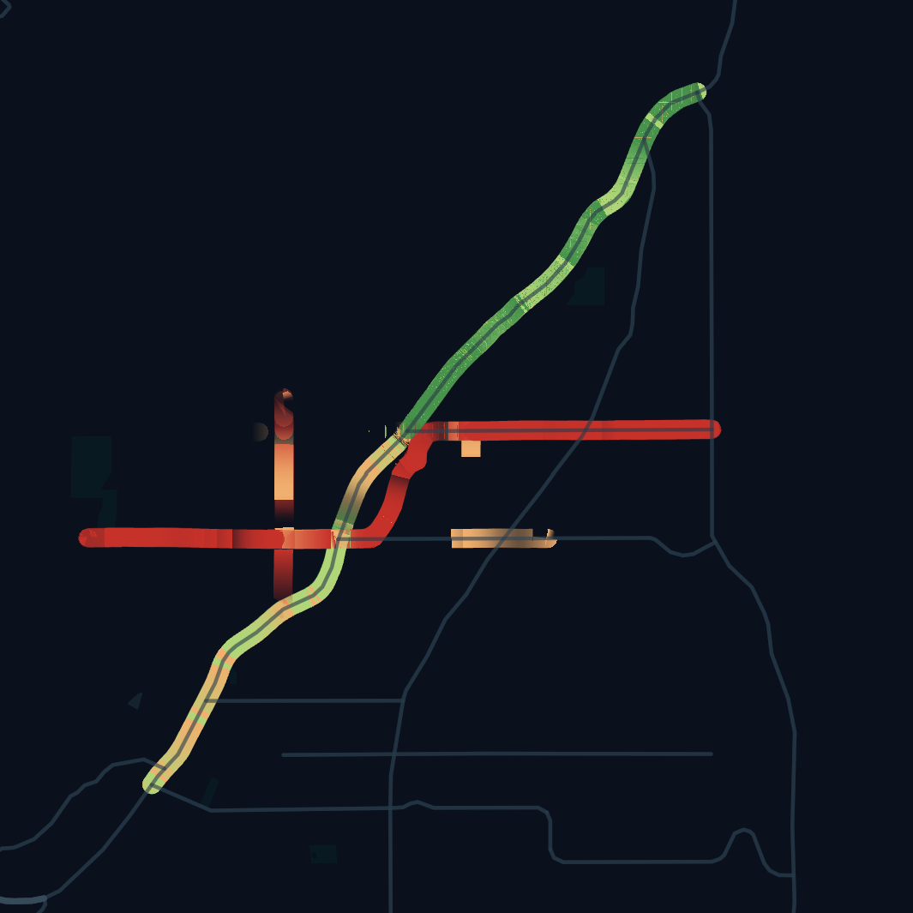
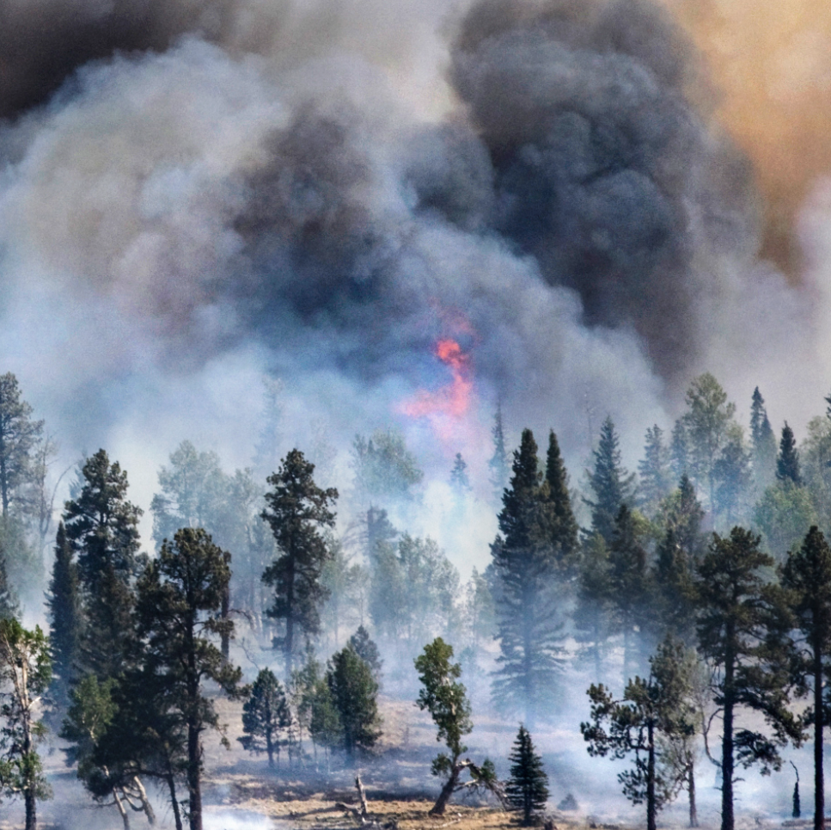
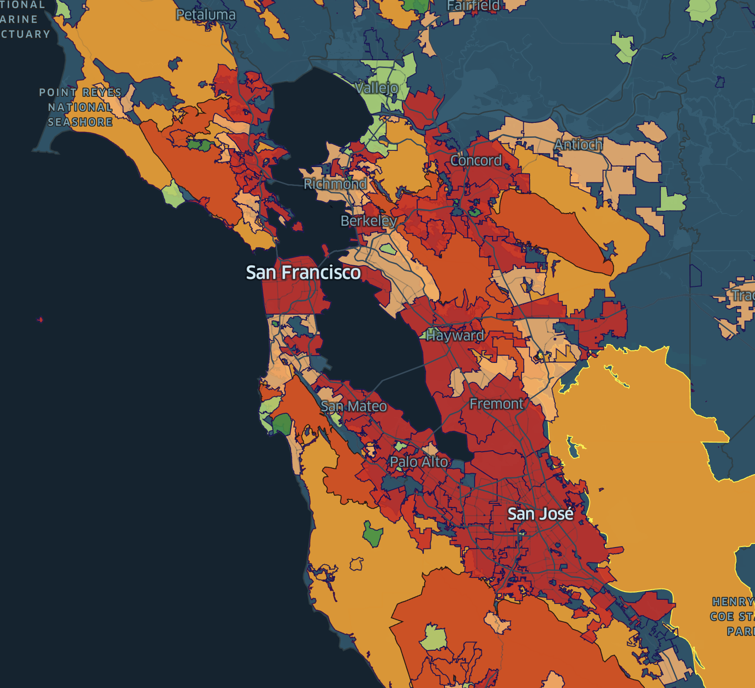
Wildfire scenarios
Census
data
Census
data
Traffic simulations
Products
roadway connectivity
roadway resilience
evacuation times

Slide 3
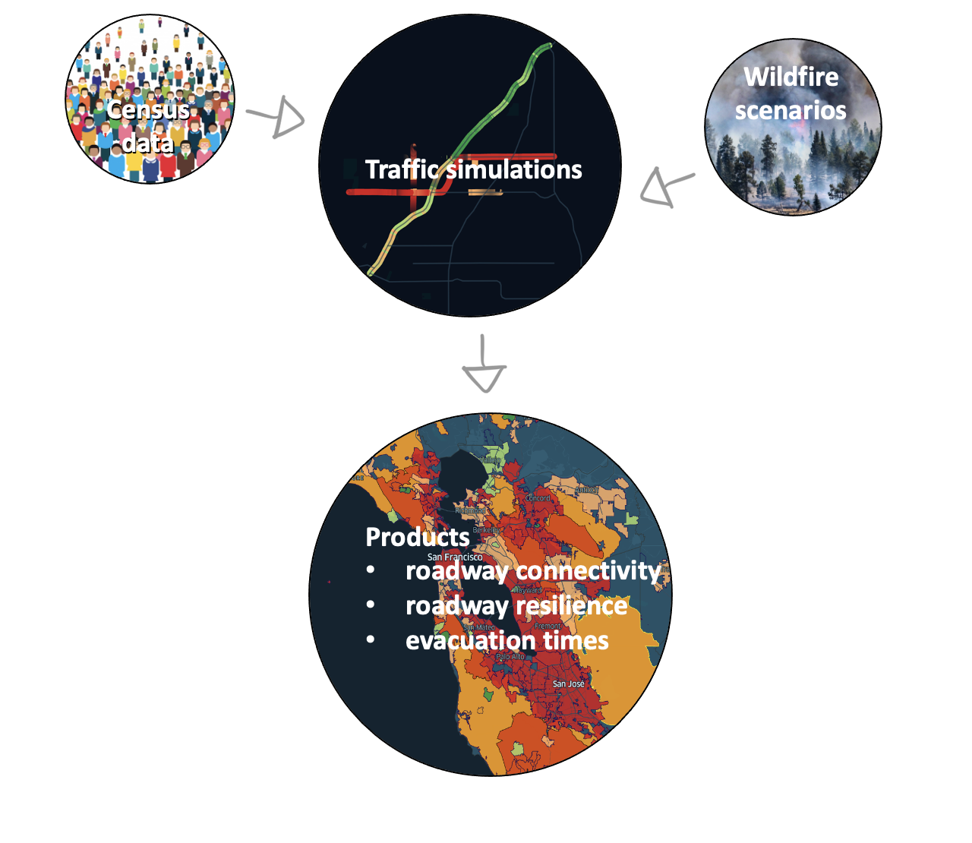
Satellite imagery
Street Views
Open street maps
Lane configuration data

